Slide 1
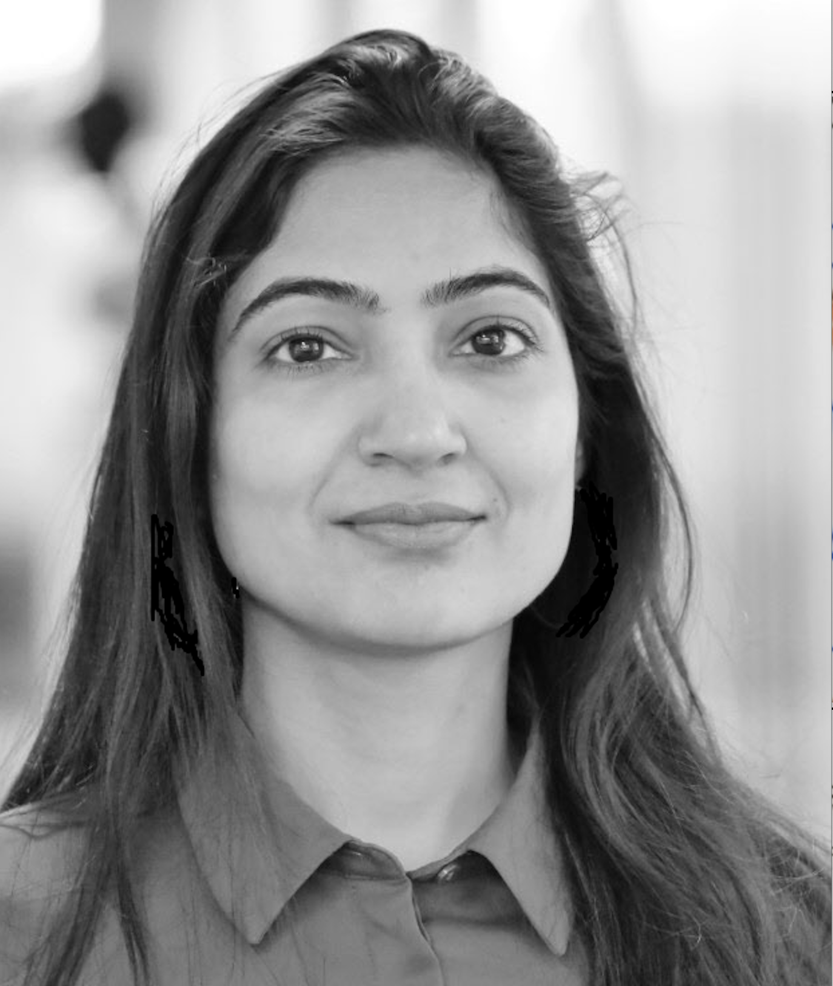
NoSQL, YesCosmos: Build that Eventually Consistent Application using Azure Cosmos DB
Teena Idnani,
Senior Lead Software Engineer, JP Morgan Chase,
LinkedIn: @teenaidnani

Slide 2
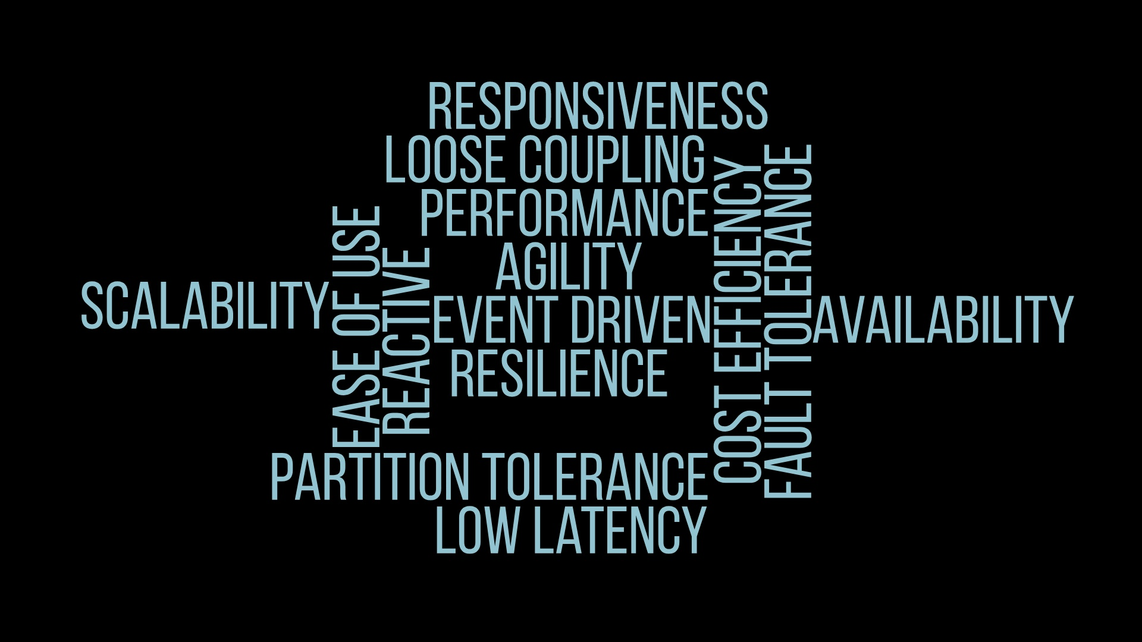

Slide 3

Distributed Services: Scenario
Order
Service
Invoice Service
Customer
?

Slide 4
Orchestrated Request-Based Pattern
Introduces latency and additional responsibility on orders service
Order
Service
Invoice Service
Customer
Order Service needs to orchestrate

Slide 5
Background Synchronization Pattern
Order
Service
Invoice Service
Customer
Offers simplicity and decouples services, but introduces delays
Background Batch Job

Slide 6

Event Based Pattern
Order
Service
Invoice Service
Customer
Async pub-sub messaging to achieve Eventual Consistency
Events

Slide 7
Event Based Pattern – Scalability, Performance and Availability
Notification
Service
Delivery Service
Customer
Order
Service
Invoice Service
Events
Async pub-sub messaging to achieve Eventual Consistency

Slide 8
Eventual Consistency is the price for better performance, scalability, and availability!

Slide 9
Azure Cosmos DB makes it easy to build highly responsive and scalable apps with flexible consistency choices

Slide 10




Key Features: Azure Cosmos DB
Globally Distributed Data
Multi-Model APIs
Automatic and Instant Scalability
Guaranteed High Availability

Slide 11
Consistency Models in Azure CosmosDB
Configured staleness in time or operations
Reads lag behind but maintain write order
Bounded Staleness
Consistent Prefix
Higher Availability, Lower Latency, Higher Throughput
Strong
Session
Eventual
Reads always return latest write
Consistency within user session, but not across sessions
Reads may return out of order writes

Slide 12
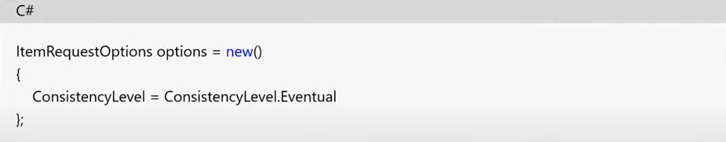
Change/Reduce consistency model with SDK
Cannot increase the strength of the consistency model used
2. Consistency only applies to the read part

Slide 13
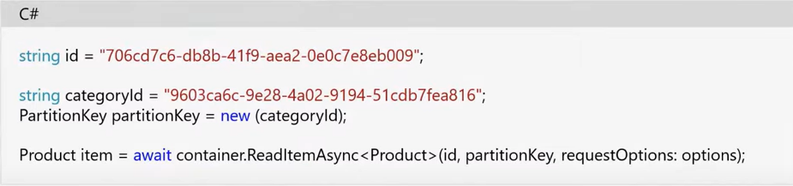
Change/Reduce consistency model with SDK
Reading the Item after setting the consistency

Slide 14
Programming for Eventual Consistency
Handling inconsistent reads
Conflict resolution
Use Change Feed
Asynchronous programming
Idempotency

Slide 15
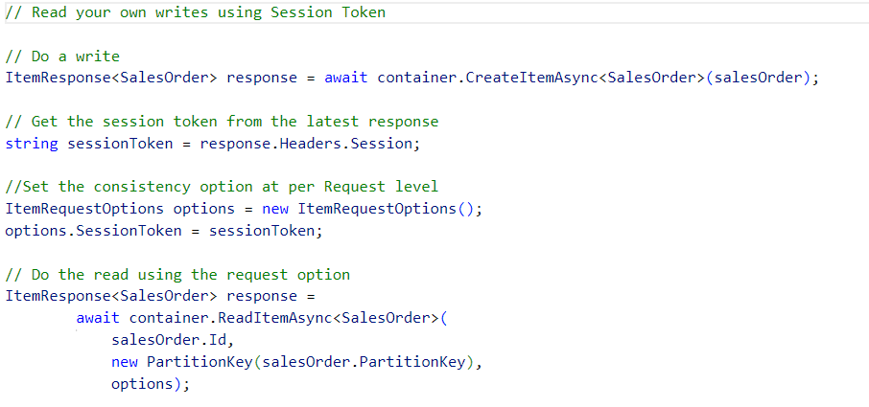
Programming for Eventual Consistency
1. Handling inconsistent reads
Always query with session tokens and handle potential stale reads by retrying with latest session.

Slide 16
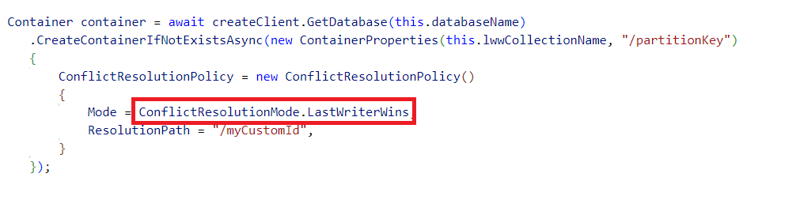
Programming for Eventual Consistency
The default path for last-writer-wins is the timestamp field or the _ts property
2.1 Conflict resolution: Create a last-writer-wins conflict resolution policy
The default path for last-writer-wins is the timestamp field or the _ts property
The default path for last-writer-wins is the timestamp field or the _ts property

Slide 17
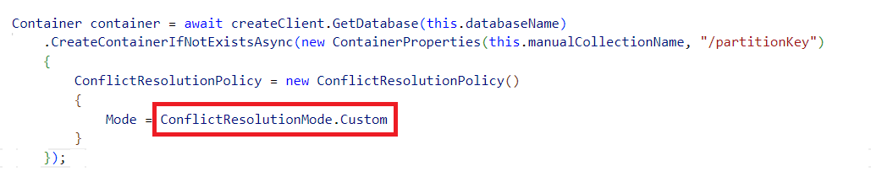
Programming for Eventual Consistency
2.2 Conflict Resolution: Create a custom conflict resolution policy
Need to register a merge stored procedure

Slide 18
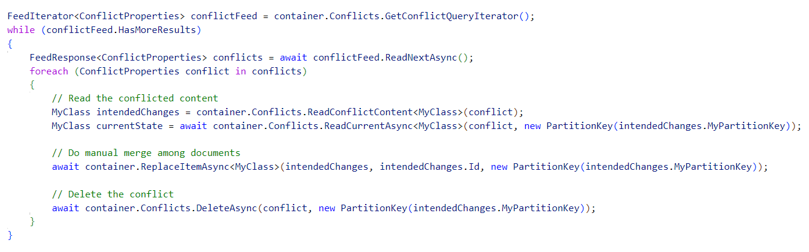
Programming for Eventual Consistency
2.3 Conflict Resolution: Handle each conflict
Each conflict will show up in the conflict feed.
It's up to you to handle the conflicts individually from the conflict feed

Slide 19
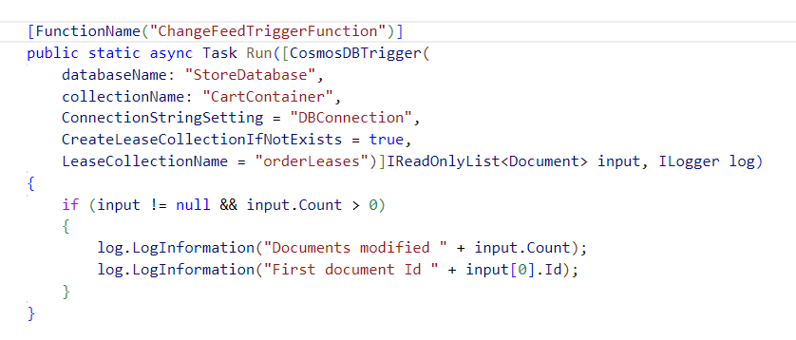
Programming for Eventual Consistency
5. Use Change Feed Triggers
to get notified about data changes

Slide 20
Event Based Pattern – Scalability, Performance and Availability
Notification
Service
Delivery Service
Customer
Order
Service
Invoice Service
Events
Async pub-sub messaging to achieve Eventual Consistency

Slide 21
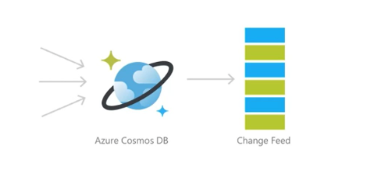
Eventual Consistency with Azure CosmosDB
Notification
Service
Delivery Service
Customer
Order
Service
Invoice Service
Events

Slide 22
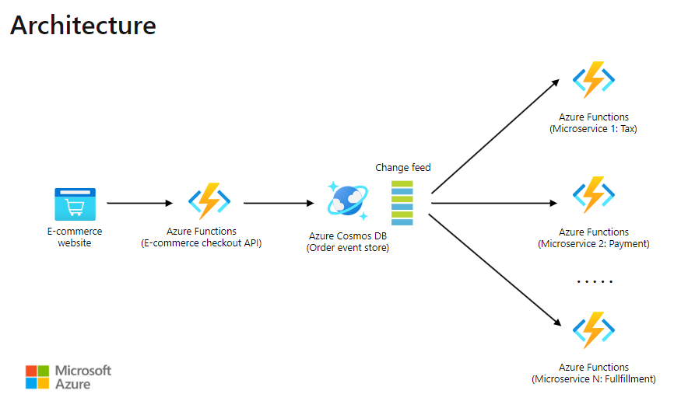

Slide 23
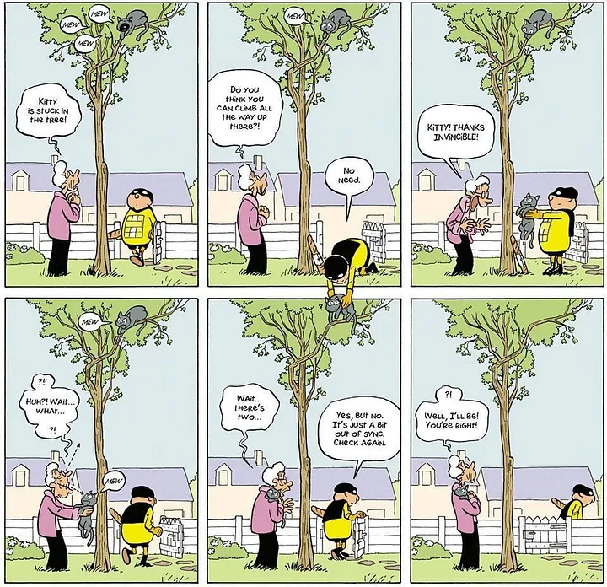
Remember … Application needs to handle
Outdated data
Conflicts
Potential Concurrency Anomalies
Events/Operations out of order
By Pascal Jousselin

Slide 24
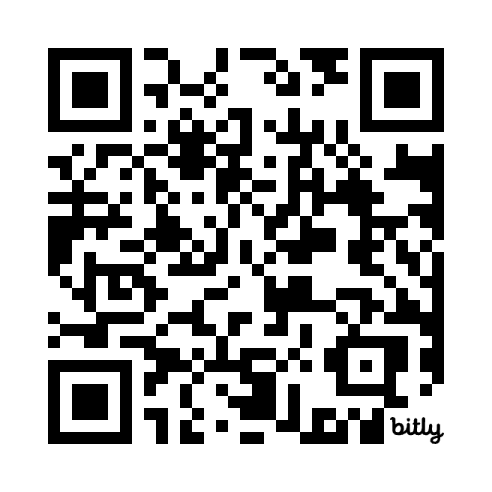
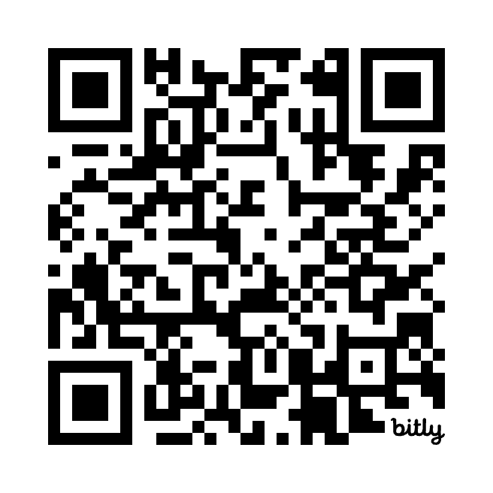
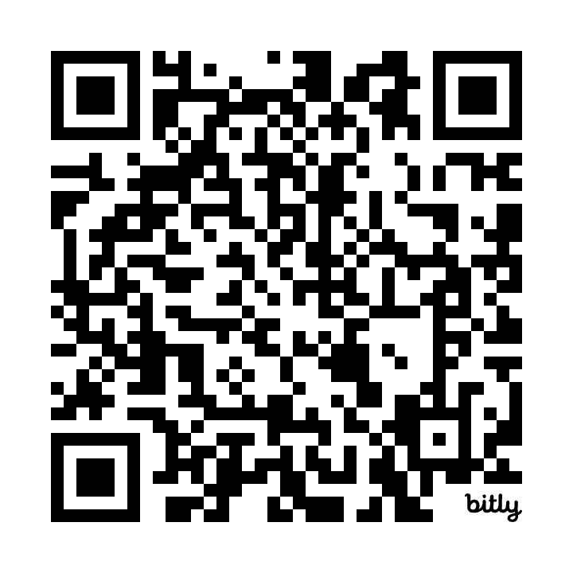
Ready to build eventually consistent apps on Azure CosmosDB?
Get started today!
Try Azure Cosmos DB
free
Azure Cosmos DB:
MS Learn
Azure Cosmos DB: Certification
https://cosmos.azure.com/try/
https://learn.microsoft.com/en-us/azure/cosmos-db/
https://learn.microsoft.com/en-us/credentials/certifications/azure-cosmos-db-developer-specialty

Slide 25
Thank You
Teena Idnani,
Senior Lead Software Engineer, JP Morgan Chase,
LinkedIn: @teenaidnani

